Slide 1
01
KEY CLUB INFORMATIONAL MEETING
2020-2021

Slide 2
MEET OUR OFFICERS!
President: Imani Sanchez
Vice President: Preesha Malladi
Secretary: Michael McGarvey
Treasurer: Burttinah Durosier
Webmaster: Hassan Usman
Editor: Jacob Benjamin
Director: Harrison Massa
Liasons: Jessilynn Keys & Zoey Varela-Castaneda
02
Division 24B LTG: Jenna Kleinman

Slide 3
Key Club is an International Student-led Organization which provides its members with opportunities to provide service build character and develop leadership.
WHAT IS KEY CLUB?
03

Slide 4
Get Service Hours!
WHY SHOULD YOU JOIN KEY CLUB?
Make a Difference in your Community
Amazing Leadership Oppertunities
You'll be a part of a larger Key Club Community
Beneficial for Colleges and Scholarships!

Slide 5
05
Volunteer to tutor Low-income students
VIRTUAL SERVICE
Volunteer to adopt a grandparent from London

Slide 6
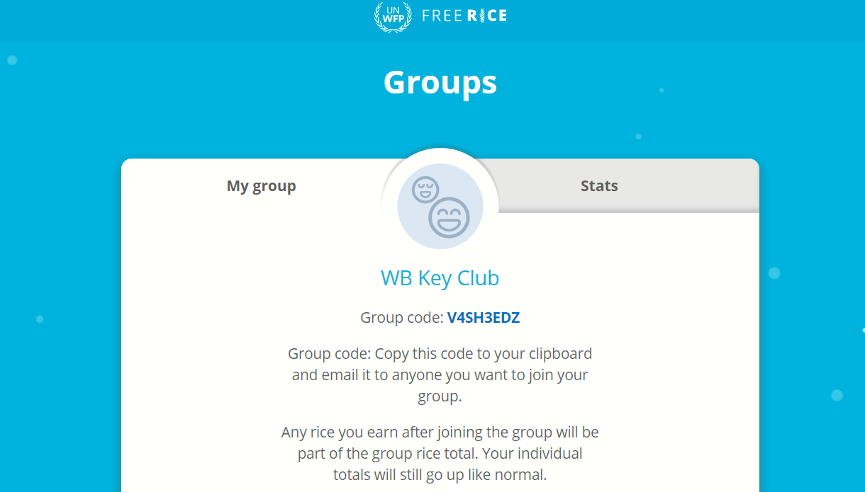
JOIN OUR FREE RICE GROUP!

Slide 7
SO,HOW CAN YOU BECOME A MEMBER?
- Attend KCKC
-Pay your Dues
-Attend meetings
07

Slide 8
WHAT IS KCKC?
The Key Club KickOff Conference is a Zone wide event (Zone J), where all members, officers, advisors, and Kiwanians come together to learn about Key Club
What: KCKC
When: Saturday, October 17th
Time: 9am-12pm
Where: Virtual on Zoom
How to register: Form will be sent out on the remind

Slide 9
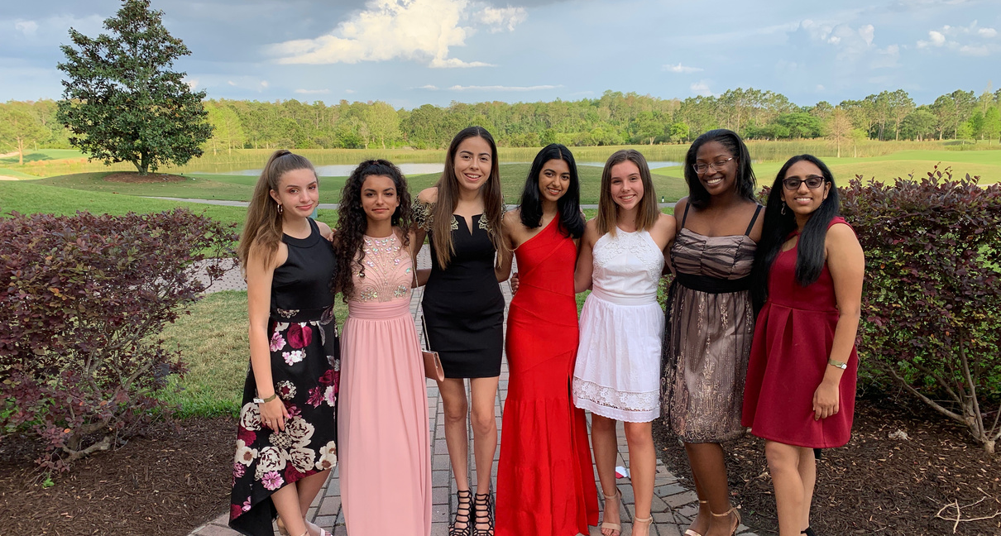
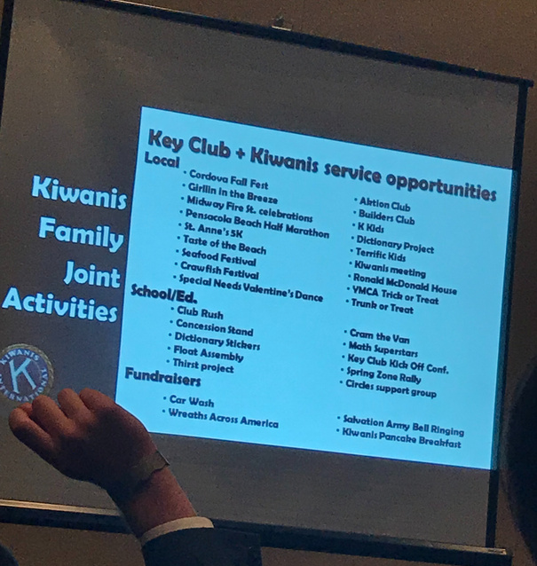
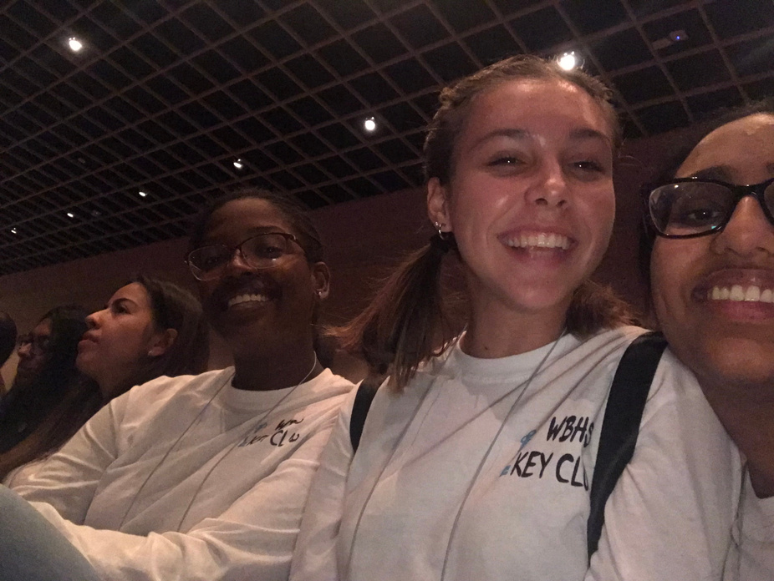
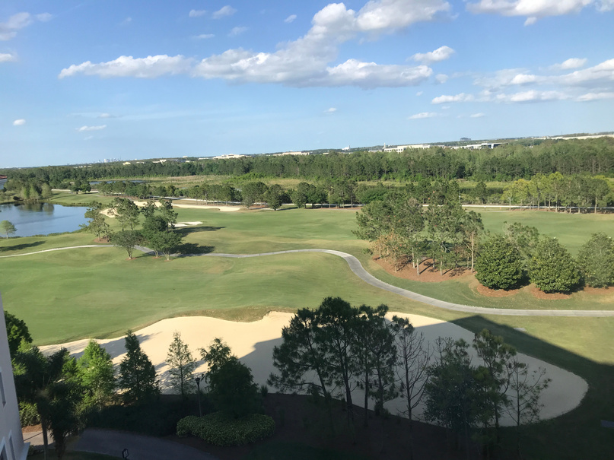
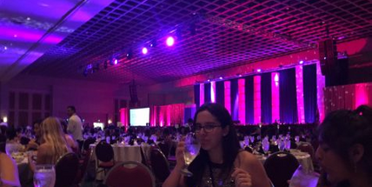
WHAT IS DCON?
The annual Florida District Education and Leadership Conference (DCON) provide trainings, keynote and motivational speakers, club awards, talent shows,and the governer's ball!
Where: Rosen Shingle Creek in Orlando,Florida
When: Early April

Slide 10
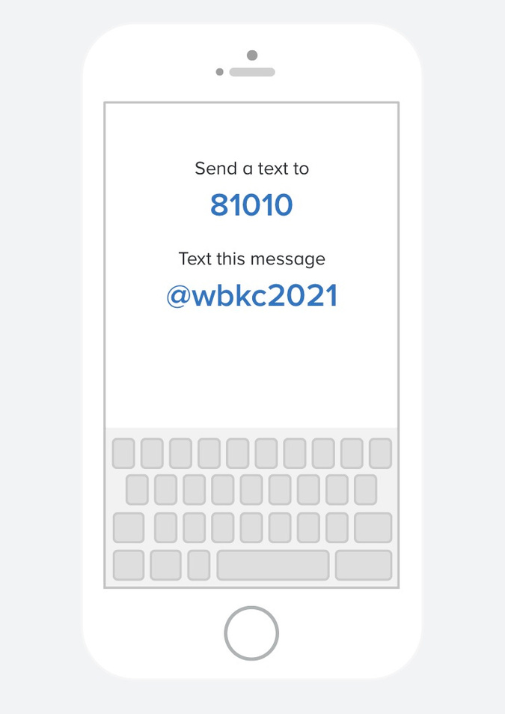
HOW TO CONTACT US
Join the Remind by texting @wbkc2021 to 81010
DM us on Instagram @wbhkeyclub
Visit our Website wbkeyclub.weebly.com
Email us wbhkeyclub@gmail.com

Slide 11
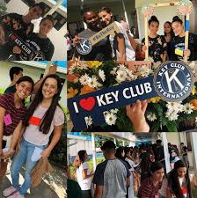
WHAT'S NEXT?
Meetings every other Tuesday @3:30pm on Microsoft Teams
Our Next meeting will be 10/27 @3:30 pm

Slide 12
QUESTIONS??
12

